Slide 1
System Security

Slide 2
Contents
Intrusion and intruder
Intrusion techniques
Intrusion prevention and detection
Password management
Password selection strategies
How to choose secure password
Virus and threats
Virus Countermeasures

Slide 3
Intruders
Also known as hackers or crackers
One of the most publicized threats to security
significant problem of networked systems
  hostile/unwanted trespass
  from benign to serious
user trespass
  unauthorized logon, privilege abuse
software trespass
  virus, worm, or Trojan horse

Slide 4
Intruders
Attacks range from harmless to devastating
  Some just want to explore
  Some read or modify sensitive data or cause disruptions
No way to tell in advance how harmful an intruder will be
  Any intruder must be considered a threat

Slide 5
Intruders
Three classes:
  Masquerader: Someone not authorized to use a computer; penetrates access controls to exploit a legitimate account
  Misfeasor: A legitimate user who accesses unauthorized resources or misuses privileges
  Clandestine user: Someone who gains supervisory control and evades or suppresses auditing and access controls
Notes:
A significant security problem for networked systems is hostile/unwanted, trespass by users or software. User trespass can take the form of unauthorized logon to a machine or, in the case of an authorized user, acquisition of privileges or performance of actions beyond those that have been authorized. Software trespass can take the form of a virus, worm, or Trojan horse. This chapter covers the subject of intruders. Intruder attacks range from the benign to the serious. At the benign end of the scale, there are many people who simply wish to explore internets and see what is out there. At the serious end are individuals who are attempting to read privileged data, perform unauthorized modifications to data, or disrupt the system
In an important early study of intrusion, Anderson identified three classes of intruders:
• Masquerader: An individual, likely an outsider, not authorized to use the computer and who penetrates a system's access controls to exploit a legitimate user's account.
• Misfeasor: A legitimate user, generally an insider, who accesses data, programs, or resources for which such access is not authorized, or who misuses authorized access.
• Clandestine user: An individual, either an outsider or an insider, who seizes supervisory control of the system and uses this control to evade auditing and access controls or to suppress audit collection

Slide 6
Example
Texas A&M University in 1992
  Received notification that one of their computers was attacking computers at a different location
  Several outside intruders involved
  The machines were disconnected by the university and security holes were patched
  A few days later, attacks resumed
  Found hundreds of captured passwords in files
  Found a bulletin board (on one of their machines) used by hackers for discussion of techniques and progress

Slide 7
Intruder Types and Behaviors
Three broad categories
  Hackers
  Criminals
  Insiders

Slide 8
Hackers
motivated by “thrill” and “status/reputation”
  hacking community is a strong meritocracy
  status is determined by level of competence
benign intruders might be tolerable
  do consume resources and may slow performance
  can’t know in advance whether benign or malign
What to do
  IDS (Intrusion Detection Systems), IPS (Intrusion Prevention System), VPNs can help to counter
Awareness of intruder problems led to establishment of CIRTs
  Computer/Cyber Incident Response Teams
  collect / disseminate vulnerability info / responses
Notes:
The techniques and behavior patterns of intruders are constantly shifting, to exploit newly discovered weaknesses and to evade detection and countermeasures. Even so, intruders typically follow one of a number of recognizable behavior patterns, and these patterns typically differ from those of ordinary users. Table 6.1a, based on [RADC04] summarizes an example of the behavior of hackers. This example is a break-in at a large financial institution. The intruder took advantage of the fact that the corporate network was running unprotected services, some of which were not even needed. In this case, the key to the break-in was the pcAnywhere application. The manufacturer, Symantec, advertises this program as a remote control solution that enables secure connection to remote devices. But the attacker had an easy time gaining access to pcAnywhere; the administrator used the same three-letter username and password for the program. In this case, there was no intrusion detection system on the 700-node corporate network. The intruder was only discovered when a vice president walked into her office and saw the cursor moving files around on her Windows workstation.
Traditionally, those who hack into computers do so for the thrill of it or for status. The hacking community is a strong meritocracy in which status is determined by level of competence. Thus, attackers often look for targets of opportunity, and then share the information with others. Benign intruders might be tolerable, although they do consume resources and may slow performance for legitimate users. However, there is no way in advance to know whether an intruder will be benign or malign. Consequently, even for systems with no particularly sensitive resources, there is a motivation to control this problem.
Intrusion detection systems (IDSs) and intrusion prevention systems (IPSs), of the type described in this chapter and Chapter 9, respectively, are designed to counter this type of hacker threat. In addition to using such systems, organizations can consider restricting remote logons to specific IP addresses and/or use virtual private network technology.
One of the results of the growing awareness of the intruder problem has been the establishment of a number of computer emergency response teams (CERTs). These cooperative ventures collect information about system vulnerabilities and disseminate it to systems managers. Unfortunately, hackers can also gain access to CERT reports. Thus, it is important for system administrators to quickly insert all software patches to discovered vulnerabilities.

Slide 9
Criminals / Criminal Enterprises
the main motivation is to make money
the common threat is organized groups of cyber criminals
  May be employed by a corporation / government
  Most of the time, loosely affiliated gangs
  Typically young
  often Eastern European, Russian, Southeast Asian
common target is financial institutions, bank accounts and credit cards on e-commerce servers
criminal hackers usually have specific targets
once penetrated act quickly and get out
IDS may help but less effective due to quick-in-and-out strategy
sensitive data needs strong data protection (e.g. credit card numbers)
Strong authentication would also help (2-factor auth.)
Notes:
Organized groups of hackers have become a widespread and common threat to Internet-based systems. These groups can be in the employ of a corporation or government, but often are loosely affiliated gangs of hackers. Typically, these gangs are young, often Eastern European or Russian hackers who do business on the Web. They meet in underground forums with names like DarkMarket.org and theftservices.com to trade tips and data and coordinate attacks. A common target is a credit card file at an e-commerce server. Attackers attempt to gain root access. The card numbers are used by organized crime gangs to purchase expensive items, and are then posted to carder sites, where others can access and use the account numbers; this obscures usage patterns and complicates investigation.
Whereas traditional hackers look for targets of opportunity, criminal hackers usually have specific targets, or at least classes of targets in mind. Once a site is penetrated, the attacker acts quickly, scooping up as much valuable information as possible and exiting.
IDSs and IPSs can also be used for these types of attackers, but may be less effective because of the quick in-and-out nature of the attack. For e-commerce sites, database encryption should be used for sensitive customer information, especially credit cards. For hosted e-commerce sites (provided by an outsider service), the e-commerce organization should make use of a dedicated server (not used to support multiple customers) and closely monitor the provider's security services.

Slide 10
Insider Attacks
Most difficult to detect and prevent
  employees have access & system knowledge
Attackers are motivated by revenge / feeling of entitlement
  when employment terminated
  taking customer data when moving to competitor
IDS/IPS may help but also need extra precautions
  least privilege (need-to-know basis)
  monitor logs
  DLP (data loss prevention) tools – sw agents monitoring user behaviors
  Upon termination revoke all rights and network access
Notes:
Insider attacks are among the most difficult to detect and prevent. Employees already have access and knowledge about the structure and content of corporate databases. Insider attacks can be motivated by revenge of simply a feeling of entitlement. An example of the former is the case of Kenneth Patterson, fired from his position as data communications manager for American Eagle Outfitters. Patterson disabled the company's ability to process credit card purchases during five days of the holiday season of 2002. As for a sense of entitlement, there have always been many employees who felt entitled to take extra office supplies for home use, but this now extends to corporate data. An example is that of a vice president of sales for a stock analysis firm who quit to go to a competitor. Before she left, she copied the customer database to take with her. The offender reported feeling no animus toward her former employee; she simply wanted the data because it would be useful to her.
Although IDS and IPS facilities can be useful in countering insider attacks, other more direct approaches are of higher priority. Examples include: enforcing least privilege, monitor logs, protect sensitive resources with strong authentication, on termination delete employee's computer and network access and make a mirror image of employee's hard drive before reissuing it.

Slide 11
Insider Behavior Example
create accounts for themselves and their friends
access accounts and applications they wouldn't normally use for their daily jobs
conduct furtive instant-messaging chats
visit web sites that cater to disgruntled employees
perform large downloads, file copying and printing
access the network during off hours.
Notes:
Table 6.1c, based on [RADC04] summarizes examples of insider behavior.

Slide 12
Intrusion
  An intrusion is a deliberate unauthorized attempt, successful or not, to break into, access, manipulate, or misuse some valuable property and where the misuse may result into or render the property unreliable or unusable.
  The person who intrudes is an intruder.

Slide 13
Intrusion
Entrance by force or without permission or welcome.
Any set of actions that attempt to compromise the integrity, confidentiality or availability of a resource.
The intentional insertion of electromagnetic energy into transmission paths in any manner with the objective of deceiving operators or of causing confusion.

Slide 14
Intrusion techniques
Objective:
  Gain access to a system
  Or, gain more privileges on a system
Generally requires the intruder to access protected information
  Most likely, a password to a user’s account
Password file
  Passwords may be hashed (one-way function)
  Or, may only be accessible by certain accounts

Slide 15
Intrusion techniques
Learning a password
  Try default passwords for the system
  Guess
    Brute force it
    Dictionary words
    Commonly used passwords (e.g., “password”, “admin”)
    Personal information about user (e.g., name, address,
    phone number)
  Trojan horse to bypass security
  Tap line between user and system

Slide 16
Intrusion techniques
Exploit security holes
  Buffer overflows in a program running with privileges
    Run unauthorized instructions
  System does not check for invalid user input
    Disrupts data integrity
    Also run unauthorized instructions
  Software bugs

Slide 17
Examples of Intrusion
remote root compromise
web server defacement
guessing / cracking passwords
copying / viewing sensitive data / databases
running a packet sniffer to obtain username/passwords
impersonating a user to reset/learn password
  Mostly via social engineering, phishing
using an unattended and logged-in workstation
Notes:
[GRAN04] lists the following examples of intrusion:
• Performing a remote root compromise of an e-mail server
• Defacing a Web server
• Guessing and cracking passwords
• Copying a database containing credit card numbers
• Viewing sensitive data, including payroll records and medical information, without authorization
• Running a packet sniffer on a workstation to capture usernames and passwords
• Using a permission error on an anonymous FTP server to distribute pirated software and music files
• Dialing into an unsecured modem and gaining internal network access
• Posing as an executive, calling the help desk, resetting the executive’s e-mail password, and learning the new password
• Using an unattended, logged-in workstation without permission

Slide 18
Intrusion detection
  Intrusion detection is a technique of detecting unauthorized access to a computer system or a computer network.
  An intrusion into a system is an attempt by an outsider to the system to illegally gain access to the system.
  Intrusion prevention, on the other hand, is the art of preventing an unauthorized access of a system’s resources.
  The two processes are related in a sense that while intrusion detection passively detects system intrusions, intrusion prevention actively filters network traffic to prevent intrusion attempts.

Slide 19
Intrusion Detection Systems (IDSs)
An intrusion detection system (IDS) is a system used to detect unauthorized intrusions into computer systems and networks.
Intrusion detection as a technology is not new, it has been used for generations to defend valuable resources.
These are three models of intrusion detection mechanisms: anomaly-based detection, signature-based detection, and hybrid detection.

Slide 20
Intrusion detection approaches
Statistical anomaly detection: Involves the collection of data relating to the behavior of legitimate users over a period of time. Then statistical tests are applied to observed behavior to determine with a high level of confidence whether that behavior is not legitimate user behavior.

Slide 21
Intrusion detection approaches
Rule-based detection: Involves an attempt to define a set of rules that can be used to decide that a given behavior is that of an intruder.

Slide 22
Security Intrusion and Intrusion Detection – Def’ns from RFC 2828
Security Intrusion
  a security event, or combination of multiple security events, that constitutes a security incident in which an intruder gains, or attempts to gain, access to a system (or system resource) without having authorization to do so.
Intrusion Detection
  a security service that monitors and analyzes system events for the purpose of finding, and providing real-time or near real-time warning of attempts to access system resources in an unauthorized manner.
Notes:
The definitions shown from RFC 2828 (Internet Security Glossary) summarize the issues we are discussing.
IETF RFC 2828 (Internet Security Glossary) defines Security Service as: •a processing or communication service provided by a system to give a specific kind of. protection to system resources; • security services implement security policies, and are implemented by security mechanisms

Slide 23
Intrusion detection
Motivated by:
  If the intruder can be detected and ejected quickly, damage to the system is minimized
  If effective, acts as a deterrent
  Collecting information about intrusion techniques
Based on assumption that an intruder behaves differently than a legitimate user
  Behaviour overlaps
  Potential for false positives or negatives

Slide 24
Intrusion detection
Balancing act
  Strong detection… Many false alarms; system
  managers will ignore
  Weak detection… False sense of security
Two approaches:
  Statistical anomaly detection
  Rule-based detection

Slide 25
Elements of Intrusion Detection
Primary assumptions:
  System activities are observable
  Normal and intrusive activities have distinct evidence
Components of intrusion detection systems:
  From an algorithmic perspective:
    Features - capture intrusion evidences
    Models - piece evidences together
  From a system architecture perspective:
    Audit data processor, knowledge base, decision engine, alarm generation and responses

Slide 26

Components of Intrusion Detection System
Audit Records
system activities are observable
Audit Data Preprocessor
Activity Data
Detection
Models
normal and intrusive activities have distinct evidence
Detection Engine
Alarms
Action/Report
Decision
Table
Decision Engine

Slide 27
Audit records
A fundamental tool for intrusion detection and also a record of user activity that is used as input to an intrusion detection system
Two types:
  Native
    Information collected by operating system
    always available but may not contain relevant information or may not be in convenient form
  Detection-specific
    Facility implemented that collects information only needed by detection system
    Extra overhead due to having multiple collection systems in place
    Example fields:
      Subject, action, object (recipient), exception condition, resource usage, timestamp

Slide 28
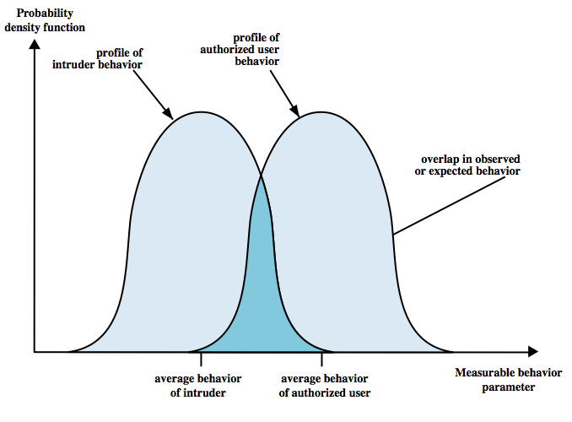
IDS Principle
Main assumption: intruder behavior differs from legitimate user behavior
  expect overlaps as shown
  problems
    false positives:
    authorized user
    identified as
    intruder
    false negatives:
    intruder not
    identified as
    intruder
Notes:
Intrusion detection is based on the assumption that the behavior of the intruder differs from that of a legitimate user in ways that can be quantified. Of course, we cannot expect that there will be a crisp, exact distinction between an attack by an intruder and the normal use of resources by an authorized user. Rather, we must expect that there will be some overlap, as shown by Figure 6.1. Patterns of legitimate user behavior can be established by observing past history, and significant deviation from such patterns can possibly be detected. Although the typical behavior of an intruder differs from the typical behavior of an authorized user, there is an overlap in these behaviors. Thus, a loose interpretation of intruder behavior, which will catch more intruders, will also lead to a number of false positives, or authorized users identified as intruders. On the other hand, an attempt to limit false positives by a tight interpretation of intruder behavior will lead to an increase in false negatives, or intruders not identified as intruders. Thus, there is an element of compromise and art in the practice of intrusion detection.

Slide 29
IDS Requirements
run continually with minimal human supervision
be fault tolerant
resist subversion
minimal overhead on system
scalable, to serve a large numbe of users
configured according to system security policies
allow dynamic reconfiguration
Notes:
[BALU98] lists the following as desirable for an IDS. It must:
• run continually with minimal human supervision.
• be fault tolerant in the sense that it must be able to recover from system crashes and reinitializations.
• resist subversion. The IDS must be able to monitor itself and detect if it has been modified by an attacker.
• impose a minimal overhead on the system where it is running.
• be able to be configured according to the security policies of the system that is being monitored.
• be able to adapt to changes in system and user behavior over time.
• be able to scale to monitor a large number of hosts.
• provide graceful degradation of service in the sense that if some components of the IDS stop working for any reason, the rest of them should be affected as little as possible.
• allow dynamic reconfiguration; that is, the ability to reconfigure the IDS without having to restart it.

Slide 30
Intrusion Detection Systems (IDS)
IDS classification
  Host-based IDS: monitor single host activity
  Network-based IDS: monitor network traffic
logical components:
  Sensors
    collect data from various sources such as log files, network packets
    sends them to the analyzer
  Analyzers
    process data from sensors and determine if intrusion has occurred
    may also provide guidance for the actions to take
  user interface
    acts as a console
    view the output and manage the behavior
Notes:
Intrusion detection systems (IDSs) can be classified as follows:
• Host-based IDS: monitors the characteristics of a single host and the events occurring within that host for suspicious activity
• Network-based IDS: monitors network traffic for particular network segments or devices and analyzes network, transport, and application protocols to identify suspicious activity
An IDS comprises three logical components:
• Sensors: Sensors are responsible for collecting data. The input for a sensor may be any part of a system that could contain evidence of an intrusion. Example types of input to a sensor are network packets, log files, and system call traces. Sensors collect and forward this information to the analyzer.
• Analyzers: Analyzers receive input from one or more sensors or from other analyzers. The analyzer is responsible for determining if an intrusion has occurred. The output of this component is an indication that an intrusion has occurred. The output may include evidence supporting the conclusion that an intrusion occurred. The analyzer may provide guidance about what actions to take as a result of the intrusion.
• User interface: The user interface to an IDS enables a user to view output from the system or control the behavior of the system. In some systems, the user interface may equate to a manager, director, or console component.

Slide 31
Host-Based IDS
specialized software to monitor system activity to detect suspicious behavior
  primary purpose is to detect intrusions, log suspicious events, and send alerts
  can detect both external and internal intrusions
two approaches, but often used in combination:
  signature detection
    attack patterns are defined and they are used to decide on intrusion
  anomaly detection
    collection of data related to the behavior of legitimate users
    Statistical tests are applied to observed behavior
      threshold detection – applies to all users
      profile based – differs among the users
Notes:
Host-based IDSs add a specialized layer of security software to vulnerable or sensitive systems, that monitors activity on the system in a variety of ways to detect suspicious behavior. An IDS may be able to halt an attack before any damage is done, but its primary purpose is to detect intrusions, log suspicious events, and send alerts. The primary benefit of a host-based IDS is that it can detect both external and internal intrusions, something that is not possible either with network-based IDSs or firewalls. Host-based IDSs follow one of two general approaches to intrusion detection, though in practice, a system may employ a combination of both approaches:
Anomaly detection: Involves the collection of data relating to the behavior of legitimate users over a period of time. Then statistical tests are applied to observed behavior to determine with a high level of confidence whether that behavior is not legitimate user behavior. In essence, anomaly approaches attempt to define normal, or expected, behavior. This approach is effective against masqueraders, who are unlikely to mimic the behavior patterns of the accounts they appropriate. On the other hand, such techniques may be unable to deal with misfeasors. The following are two approaches to statistical anomaly detection:
a. Threshold detection: involves defining thresholds, independent of user, for the frequency of occurrence of various events.
b. Profile based: of activity of each user used to detect changes in user behavior.
2. Signature detection: defines a set of rules or attack patterns used to decide that a given behavior is that of an intruder. It attempts to define proper behavior and may be able to recognize events and sequences that, in context, reveal penetration.

Slide 32
Signature Detection
Observe events on system and applying a set of rules to decide if intruder
Approaches:
  rule-based anomaly detection
    analyze historical audit records for expected behavior, then match with current behavior
  rule-based penetration identification
    rules identify known penetrations or possible penetrations due to known weaknesses
    rules are mostly OS specific
    rules obtained by analyzing attack scripts from Internet
      supplemented with rules from security experts of target system
Notes:
Signature techniques detect intrusion by observing events in the system and applying a set of rules that lead to a decision regarding whether a given pattern of activity is or is not suspicious. In very general terms, we can characterize all approaches as focusing on either anomaly detection or penetration identification, although there is some overlap in these approaches.
Rule-based anomaly detection is similar in terms of its approach and strengths to statistical anomaly detection. With the rule-based approach, historical audit records are analyzed to identify usage patterns and to generate automatically rules that describe those patterns. Rules may represent past behavior patterns of users, programs, privileges, time slots, terminals, and so on. Current behavior is then observed, and each transaction is matched against the set of rules to determine if it conforms to any historically observed pattern of behavior.
Rule-based penetration identification takes a very different approach to intrusion detection. The key feature of such systems is the use of rules for identifying known penetrations or penetrations that would exploit known weaknesses. Rules can also be defined that identify suspicious behavior, even when the behavior is within the bounds of established patterns of usage. Typically, the rules used in these systems are specific to the machine and operating system. The most fruitful approach to developing such rules is to analyze attack tools and scripts collected on the Internet. These rules can be supplemented with rules generated by knowledgeable security personnel. In this latter case, the normal procedure is to interview system administrators and security analysts to collect a suite of known penetration scenarios and key events that threaten the security of the target system.

Slide 33
Anomaly Detection
Threshold detection
  Checks excessive event occurrences over time
  Crude and ineffective intruder detector per se
  Creates lots of false positives/negatives due to
    Variance in time
    Variance accross users
Profile based
  Characterize past behavior of users and groups
  Then, detect significant deviations
  Based on analysis of audit records
    example metrics: counter, guage, interval timer, resource utilization
    analysis methods: mean and standard deviation, multivariate, markov process, time series
Notes:
Threshold detection involves counting the number of occurrences of a specific event type over an interval of time. If the count surpasses what is considered a reasonable number that one might expect to occur, then intrusion is assumed. Threshold analysis, by itself, is a crude and ineffective detector of even moderately sophisticated attacks. Both the threshold and the time interval must be determined. Because of the variability across users, such thresholds are likely to generate either a lot of false positives or a lot of false negatives. However, simple threshold detectors may be useful in conjunction with more sophisticated techniques.
Profile-based anomaly detection focuses on characterizing the past behavior of individual users or related groups of users and then detecting significant deviations. A profile may consist of a set of parameters, so that deviation on just a single parameter may not be sufficient in itself to signal an alert. The foundation of this approach is an analysis of audit records. The audit records provide input to the intrusion detection function in two ways. First, the designer must decide on a number of quantitative metrics that can be used to measure user behavior. Examples incude: counter, guage, interval timer, resource utilization. An analysis of audit records over a period of time can be used to determine the activity profile of the average user. Thus, the audit records serve to define typical behavior. Second, current audit records are the input used to detect intrusion. That is, the intrusion detection model analyzes incoming audit records to determine deviation from average behavior. Various tests can be performed to determine whether current activity fits within acceptable limits, such as: mean and standard deviation, multivariate model, markov process model, time series model, operational model.

Slide 34
Profile based Anomaly Detection - Analysis Methods
Mean and standard deviation
  of a particular parameter
  Not good (too crude)
Multivariate analysis
  Correlations among several parameters (ex. relation between login freq. and session time)
Markov process
  Considers transition probabilities
Time series analysis
  Analyze time intervals to see sequences of events happening rapidly or slowly
All statistical methods using AI, Mach. Learning and Data Mining techniques.

Slide 35
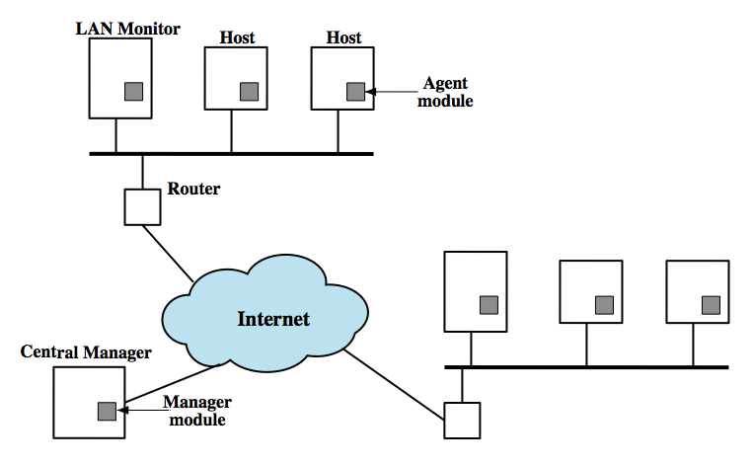
Distributed Host-Based IDS main idea: coordination and cooperation among IDSs across the network
Host agent module: audit collection module; sent to central manager
LAN Monitor agent module: analyze LAN traffic and send to Central Manager
Central Manager Module: Analyze and correlate data received from other modules
Architecture
Notes:
Traditionally, work on host-based IDSs focused on single-system stand-alone facilities. A more effective defense of a distributed collection of hosts supported by a LAN or internetwork can be achieved by coordination and cooperation among IDSs across the network. A good example of a distributed IDS is one developed at the University of California at Davis. The scheme is designed to be independent of any operating system or system auditing implementation. Figure 6.2 here shows the overall architecture, which consists of three main components:
• Host agent module: An audit collection module operating as a background process on a monitored system. Its purpose is to collect data on security-related events on the host and transmit these to the central manager.
• LAN monitor agent module: Operates in the same fashion as a host agent module except that it analyzes LAN traffic and reports the results to the central manager.
• Central manager module: Receives reports from LAN monitor and host agents and processes and correlates these reports to detect intrusion.

Slide 36
Network-Based IDS
network-based IDS (NIDS)
  monitor traffic at selected points on a network to detect intrusion patterns
    in (near) real-time
  may examine network, transport and/or application level protocol activity directed toward the system to be protected
    Only network packets, no software activity examined
System components
  A number of sensors to monitor packet traffic
  Management server(s) with console (GUI)
Analysis can be done at sensors, at management servers or both
Notes:
A network-based IDS (NIDS) monitors traffic at selected points on a network or interconnected set of networks. The NIDS examines the traffic packet by packet in real time, or close to real time, to attempt to detect intrusion patterns. The NIDS may examine network, transport and/or application level protocol activity. Note the contrast with a host-based IDS. A NIDS examined packet traffic directed toward potentially vulnerable computer systems on a network. A host-based system examines user and software activity on a host.
A typical NIDS facility includes a number of sensors to monitor packet traffic, one or more servers for NIDS management functions, and one or more management consoles for the human interface. The analysis of traffic patterns to detect intrusions may be done at the sensor, at the management server, or some combination of the two.

Slide 37
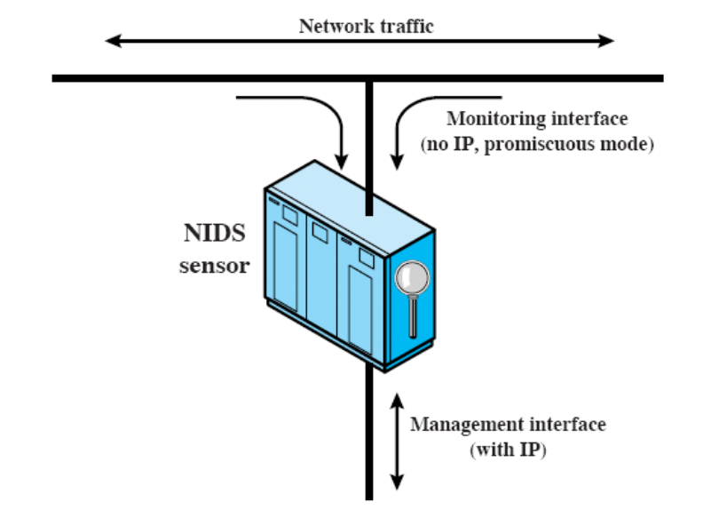
Network-Based IDS
Types of sensors
  inline and passive
Inline sensors
  Inserted into a network segment
  Traffic pass through
  possibly as part of other networ-
  king device (e.g. router, firewall)
    No need for a new hardware; only new software
  May create extra delay
  Once attack is detected, traffic is blocked
    Also a prevention technique
Passive sensors
  monitors copy of traffic at background
    Traffic does not pass through it, so there is no blocking capability
  More efficient, therefore more common
Passive sensor
Notes:
Sensors can be deployed in one of two modes: inline and passive. An inline sensor is inserted into a network segment so that the traffic that it is monitoring must pass through the sensor, possibly by combining NIDS sensor logic with another network device (e.g. firewall, LAN switch). A passive sensor monitors a copy of network traffic; the actual traffic does not pass through the device. From the point of view of traffic flow, the passive sensor is more efficient than the inline sensor, because it does not add an extra handling step that contributes to packet delay. The sensor connects to the network transmission medium by a direct physical tap that provides the sensor with a copy of all network traffic. The network interface card (NIC) for this tap usually does not have an IP address. All traffic into this NIC is simply collected with no protocol interaction with the network. The sensor has a second NIC that connects to the network with an IP address and enables the sensor to communicate with a NIDS management server.

Slide 38
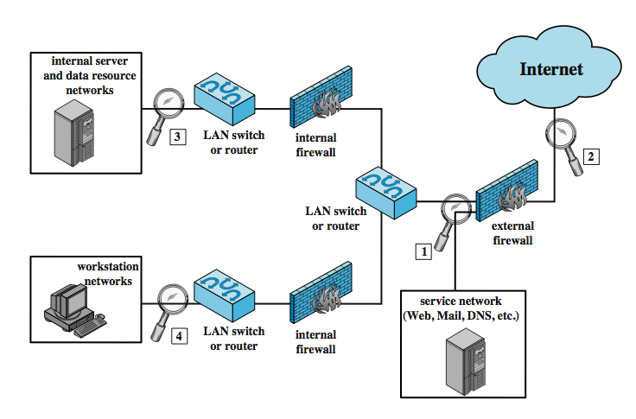
NIDS Sensor Deployment
Notes:
Within a single site, a key decision for the security administrator is the placement of the sensors. Figure 6.5 illustrates a number of possibilities. In general terms, this configuration is typical of larger organizations. All Internet traffic passes through an external firewall that protects the entire facility. Internal firewalls may also be used to provide more specific protection to certain parts of the network.
A common location for a NIDS sensor is just inside the external firewall (location 1 in the figure), where it can attacks, originating from the outside world. Instead of placing a NIDS sensor inside the external firewall, the security administrator may choose to place a NIDS sensor between the external firewall and the Internet or WAN (location 2). In this position, the sensor can monitor all network traffic, unfiltered. A sensor at location 2 has a higher processing burden than any sensor located elsewhere on the site network. In addition to a sensor at the boundary of the network, on either side of the external firewall, the administrator may configure a firewall and one or more sensors to protect major backbone networks, such as those that support internal servers and database resources (location 3). Thus, a sensor at location 3 is able to monitor for both internal and external attacks. Because the sensor monitors traffic to only a subset of devices at the site, it can be tuned to specific protocols and attack types, reducing the processing burden. Finally, the network facilities at a site may include separate LANs that support user workstations and servers specific to a single department. The administrator could configure a firewall and NIDS sensor to provide additional protection for all of these networks or target the protection to critical subsystems, such as personnel and financial networks (location 4). As with a sensor at location 3, a sensor at location 4 can be tuned to specific protocols and attack types, reducing the processing burden.

Slide 39
Intrusion Detection Techniques in NIDS
signature detection
  at application (mostly), transport, and network layers
  Attack patterns are detected in packets
anomaly detection – attacks that cause abnormal behaviors are detected
  denial of service attacks, scanning attacks
when potential violation detected, sensor sends an alert and logs information
Notes:
As with host-based intrusion detection, network-based intrusion detection makes use of signature detection and anomaly detection.
Some examples suitable for signature detection include:
• Application layer reconnaissance and attacks: analyze several dozen application protocols looking for attack patterns identified as targeting these protocols.
• Transport layer reconnaissance and attacks: analyze TCP / UDP / other transport-layer protocols for unusual packet fragmentation, port scans, TCP-specific attacks etc
• Network layer reconnaissance and attacks: typically analyze IPv4, ICMP, and IGMP for spoofed IP addresses, illegal IP header values, etc
• Unexpected application services: to determine if activity consistent with protocol
• Policy violations: such as use of inappropriate Web sites,use forbidden protocols etc
Some examples of types of attacks suitable for anomaly detection are:
• Denial of service (DoS) attacks: involve either significantly increased packet traffic or significantly increase connection attempts, to overwhelm the target system.
• Scanning: occurs when an attacker probes a target network or system by sending different kinds of packets to learn many of the system’s characteristics/vulnerabilities.
• Worms: detected because of use of large amounts of bandwidth, or because they can cause hosts to communicate with other hosts/ports not typically seen.
When a sensor detects a potential violation it sends an alert and logs information related to the event. The NIDS analysis module uses this to refine intrusion detection parameters and algorithms, and by the security admin to design prevention techniques.

Slide 40
Rule-based detection
Attempts to define a set of rules with regards to what is legitimate or intrusive behaviour

Slide 41
Rule-based detection
Two categories:
  Anomaly detection
    Similar to statistical anomaly detection
    Usage patterns are identified and rules are generated to describe such patterns in behaviour
    Current behaviour is observed and compared to past behaviour
  Penetration identification
    Rules are defined with regards to known penetrations, ways to exploit system weaknesses, and suspicious behaviour
    Rules are generated by experts; interviews are conducted with administrators, security analysts, or hackers themselves

Slide 42
Distributed intrusion detection
A detection system that monitors behaviour across a network of systems
Major issues to consider:
  May need to deal with multiple formats of audit records
  Audit records will need to be transferred through the network to a node with the detection system
    Data integrity and confidentiality
  Centralization
    One node… Single point of failure
    Many nodes… Must coordinate

Slide 43
An Example IDS: Snort
Lightweight IDS
  open source
  Portable, efficient
  easy deployment and configuration
  May work in host-based and network-based manner
Snort can perform
  real-time packet capture and rule analysis
Sensors can be inline or passive
  In inline case, Snort can also be used as IPS
Notes:
Snort is an open source, highly configurable and portable host-based or network-based IDS. Snort is referred to as a lightweight IDS. Snort can perform real-time packet capture, protocol analysis, and content searching and matching. Snort can detect a variety of attacks and probes, based on a set of rules configured by a system administrator. A Snort implementation can be configured as a passive sensor, which monitors traffic but is not in the main transmission path of the traffic, or an inline sensor. In the latter case, Snort can perform intrusion prevention as well as intrusion detection.
Snort is an open source network intrusion detection system (NIDS) created by Martin Roesch. Snort is a packet sniffer that monitors network traffic in real time, scrutinizing each packet closely to detect a dangerous payload or suspicious anomalies.
If you put Snort outside of the firewall, it can monitor external attacks on your network, but won't see most internal traffic. If you put Snort behind the firewall, it can monitor internal traffic and attacks that manage to breach the firewall, but not attacks blocked by the firewall.

Slide 44
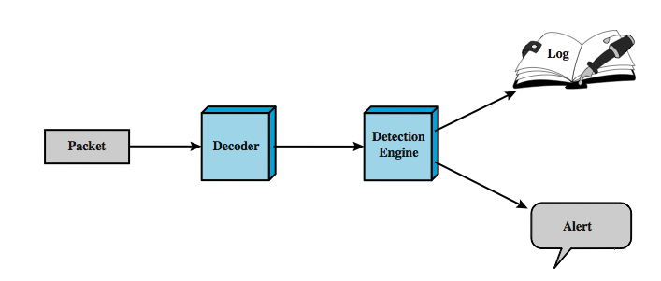
Snort Architecture
Packet Decoder: parses the packet headers in all layers
Detection Engine: actual IDS. Rule-based analysis.
If the packet matches a rule, the rule specifies logging and alerting options
Notes:
A Snort installation consists of four logical components, shown here in Figure 6.7:
• Packet Decoder: efficiently processes each captured packet to identify and isolate protocol headers at the data link, network, transport, and application layers.
• Detection Engine: does actual work of intrusion detection, analyzing each packet using rules defined for this configuration of Snort by the security administrator.
• Logger: of each packet that matches a rule, if specified. The security administrator can then use the log file for later analysis.
• Alerter: can be sent for each detected packet to a file, a UNIX socket, or a database.

Slide 45
SNORT Rules
Snort uses a simple, flexible and effective rule definition language
  But needs training to be an expert on it
Each rule has a fixed header and zero or more options
Header fields
  action: what to do if matches – alert, drop, pass, etc.
  protocol: analyze further if matches - IP, ICMP, TCP, UDP
  source IP: single, list, any, negation
  source port: TCP or UDP port; single, list, any, negation
  direction: unidirectional (->) or bidirectional (<->).
  dest IP, dest port: same format as sources
Notes:
Snort uses a simple, flexible rule definition language that generates the rules used by the detection engine. Although the rules are simple and straightforward to write, they are powerful enough to detect a wide variety of hostile or suspicious traffic. Each rule consists of a fixed header and zero or more options. The header includes:
• Action: tells Snort what to do when it finds a packet that matches the rule criteria (alert, log, pass, activate, dynamic, drop, reject, sdrop)
• Protocol: if packet protocol matches this field then analysis proceeds
• Source IP address: source of packet
• Source port: for the specified protocol (e.g.,a TCP port).
• Direction: unidirectional (->) or bidirectional (<->).
• Destination IP address: destination of packet.
• Destination port
Following the rule header may be one or more rule options. Each option consists of an option keyword, which defines the option; followed by arguments, which specify the details of the option. Table 6.5 in the text gives examples of options in each category.
The example shown of a Snort rule checks detects a type of attack at the TCP level known as a SYN-FIN attack. It has specified source and destination networks, and checks if the SYN and the FIN bits are set, ignoring reserved bit 1 and reserved bit 2 in the flags octet. The reference option refers to an external definition of this attack, which is of type attempted-recon.

Slide 46
Intrusion Prevention Systems (IPS)
Later addition to terminology of security products
Two Interpretations of IPS
  inline network or host-based IDS that can block traffic
  functional addition IDS capabilities to firewalls
An IPS can block traffic like a firewall, but using IDS algorithms
  may be network or host based
Inline Snort is actually an IPS

Slide 47
Intrusion Prevention Systems (IPSs)
Although IDS have been one of the cornerstones of network security, they have covered only one component of the total network security picture since they have been and they are a passive component which only detects and reports without preventing.
A promising new model of intrusion is developing and picking up momentum. It is the intrusion prevention system (IPS) which, is to prevent attacks.
Like their counterparts the IDS, IPS fall into two categories: network-based and host-based.

Slide 48
Network-Based Intrusion Prevention Systems (NIPSs)
  Because NIDSs are passively detecting intrusions into the network without preventing them from entering the networks, many organizations in recent times have been bundling up IDS and firewalls to create a model that can detect and then prevent.
  The bundle works as follows.
    The IDS fronts the network with a firewall behind it. On the detection of an attack, the IDS then goes into the prevention mode by altering the firewall access control rules on the firewall. The action may result in the attack being blocked based on all the access control regimes administered by the firewall.
    The IDS can also affect prevention through the TCP resets; TCP utilizes the RST (reset) bit in the TCP header for resetting a TCP connection, usually sent as a response request to a non-existent connection.

Slide 49
Host-Based Intrusion Prevention Systems (HIPSs)
  Most HIPSs work by sand-boxing, a process of restricting the definition of acceptable behavior rules used on HIPSs. HIPS prevention occurs at the agent residing at the host.
  The agent intercept system calls or system messages by utilizing dynamic linked libraries (dll) substitution.
  The substitution is accomplished by injecting existing system dlls with vendor stub dlls that perform the interception.

Slide 50
Honeypots
  A honeypot is a system designed to look like something that an intruder can hack.
  They are built for many purposes but the overriding one is to deceive attackers and learn about their tools and methods.
  Honeypots are also add-on/tools that are not strictly sniffer-based intrusion detection systems like HIDS and NIDS. However, they are good deception systems that protect the network in much the same way as HIDS and NIDS.
  Since the goal for a honeypot is to deceive intruders and learn from them without compromising the security of the network, then it is important to find a strategic place for the honeypot.
Notes:
A honeypot is a network-attached system set up as a decoy to lure cyber attackers and detect, deflect and study hacking attempts to gain unauthorized access to information systems. The function of a honeypot is to represent itself on the internet as a potential target for attackers -- usually, a server or other high-value asset -- and to gather information and notify defenders of any attempts to access the honeypot by unauthorized users.
A software program that is designed to appear to be a real functioning network but is actually a decoy built specifically to be probed and attacked by malicious users. In contrast to a honeypot, which is typically a hardware device that lures users into its trap, a virtual honeypot uses software to emulate a network.

Slide 51
Honeypots
two primary types of honeypot designs:
  Production honeypots—serve as decoy systems inside fully operating networks and servers, often as part of an intrusion detection system (IDS).
  Research honeypots—used for educational purposes and security enhancement.

Slide 52
Need for Password
because of the widespread adoption of computer networks, and particularly the Internet, has enabled electronic access to almost every possible service: e-mail, e-commerce, banking and government services.
But with this access has come the need to identify the users of these services, both to safeguard personal information and to control the capabilities given to each user.
An encrypted password database is likely to be much more secure than a notebook or a wallet.

Slide 53
Need for Password
Because of the difficulties associated with remembering passwords, a group of software applications, called password keepers or password managers has emerged.
These applications deal with everything from the simple storage of user IDs and passwords to the management of password access across many users.
Poor encryption or use of a weak master password, allowing the contents to be accessed.

Slide 54
Password management
A password system is almost always the front line of defense
Each user has a username (or ID) and password
  Username determines what privileges that user has
  A guest or anonymous account may also exist with very limited privileges
  Password is used for authentication when logging in

Slide 55
Password Management
Password Protection:
  The front line of defense against intruders is the password system.
  Virtually all multiuser systems require that a user provide not only a name or identifier (ID) but also a password.
  The password serves to authenticate the ID of the individual logging on to the system.

Slide 56
Password Management
The ID determines whether the user is authorized to gain access to a system.
The ID determines the privileges accorded to the user.

Slide 57
Password vulnerabilities
A password file typically does not store passwords as plaintext
  A unique salt (e.g., username) is attached to a user’s password, encrypted using some algorithm, then stored
  Having obtained the password file, an intruder would need to decrypt the passwords contained in it…not necessarily an easy task
This is fine, but…if someone’s password is “password”, it doesn’t matter how secure your password file is

Slide 58
Password vulnerabilities
Some people choose passwords that are easy to guess
  Dictionary words
  Personal information
Or, too short in length
  System may enforce a minimum length
Strategy to obtain a password
  Try personal information
  Try dictionary words
  Try exchanging letters with lookalike symbols (e.g., letter O with number zero)
  Try varying capitalization
This allows for a password to be obtained without having to actually decrypt it the password file

Slide 59
Password vulnerabilities
Password file is most likely only accessible by certain accounts
Some users may use the same password for a variety of systems
  Intruder may obtain their password from one system and try it on another

Slide 60
Password selection
Users may choose a password that is easy to remember…insecure because easily guessable
System may assign a randomly generated password…secure, but not easy to remember
Goal: generate a password that is not easy to guess, but is easy to remember

Slide 61
Password selection
Password Selection Strategies: The goal is to eliminate guessable passwords while allowing the user to select a password that is memorable. Four basic techniques are in use:
  User education: Users can be told the importance of using hard-to-guess passwords and can be provided with guidelines for selecting strong passwords.
  Computer-generated passwords: Use an algorithm (e.g., produce a password with pronounceable syllables) to generate a user’s password and are quite random in nature

Slide 62
Password Management
Reactive password checking
  the system periodically runs its own password checker and cracker to find guessable or weak passwords. The system cancels any passwords that are guessed
Proactive password checking
  user is allowed to select his or her own password. However, at the time of selection, the system checks to see if the password is allowable and, if not, rejects it.
  The trick with a proactive password checker is to strike a balance between user acceptability and strength.

Slide 63
Password Management
Proactive password checking approaches:
  Rule enforcement:
    All passwords must be at least eight characters long.
    The passwords must include at least one each of uppercase, lowercase, numeric digits, and punctuation marks.
  Another possible procedure is simply to compile a large dictionary of possible "bad" passwords.

Slide 64
Password Management
Proactive password checker techniques
  Markov model: generation of guessable passwords, this model shows a language consisting of an alphabet of three characters. The state of the system at any time is the identity of the most recent letter. The value on the transition from one state to another represents the probability that one letter follows another. Thus, the probability that the next letter is b, given that the current letter is a, is 0.5.

Slide 65
How to Choose a secure password?
Do NOT use words or phrases that have personal significance.
Mix letters, numbers and symbols, and use case sensitivity
Try to memorize the password, and avoid writing it down
Do not use the same password for everything
Use a password manager (PM). It is a utility that creates an encrypted file where your passwords are stored.
Try to use "nonsense words."
Do not tell anybody your password.

Slide 66
Viruses and ”Malicious Programs”
Computer “Viruses” and related programs have the ability to replicate themselves on an ever increasing number of computers. They originally spread by people sharing floppy disks. Now they spread primarily over the Internet (a “Worm”).
Other “Malicious Programs” may be installed by hand on a single machine. They may also be built into widely distributed commercial software packages. These are very hard to detect before the payload activates (Trojan Horses, Trap Doors, and Logic Bombs).

Slide 67
Taxanomy of Malicious Programs
Malicious Programs
Need Host Program
Independent
Trapdoors
Logic Bombs
Trojan
Horses
Viruses
Bacteria
Worms

Slide 68
Definitions
Virus - code that copies itself into other programs.
A “Bacteria” replicates until it fills all disk space, or CPU cycles.
Payload - harmful things the malicious program does, after it has had time to spread.
Worm - a program that replicates itself across the network (usually riding on email messages or attached documents (e.g., macro viruses).

Slide 69
Definitions
Trojan Horse - instructions in an otherwise good program that cause bad things to happen (sending your data or password to an attacker over the net).
Logic Bomb - malicious code that activates on an event (e.g., date).
Trap Door (or Back Door) - undocumented entry point written into code for debugging that can allow unwanted users.
Easter Egg - extraneous code that does something “cool.” A way for programmers to show that they control the product.

Slide 70
Virus Phases
Dormant phase - the virus is idle
Propagation phase - the virus places an identical copy of itself into other programs
Triggering phase – the virus is activated to perform the function for which it was intended
Execution phase – the function is performed

Slide 71
Types of Viruses
Parasitic Virus - attaches itself to executable files as part of their code. Runs whenever the host program runs.
Memory-resident Virus - Lodges in main memory as part of the residual operating system.
Boot Sector Virus - infects the boot sector of a disk, and spreads when the operating system boots up (original DOS viruses).
Stealth Virus - explicitly designed to hide from Virus Scanning programs.
Polymorphic Virus - mutates with every new host to prevent signature detection.

Slide 72
Macro Viruses
Microsoft Office applications allow “macros” to be part of the document. The macro could run whenever the document is opened, or when a certain command is selected (Save File).
Platform independent.
Infect documents, delete files, generate email and edit letters.

Slide 73
Antivirus Approaches
1st Generation, Scanners: searched files for any of a library of known virus “signatures.” Checked executable files for length changes.
2nd Generation, Heuristic Scanners: looks for more general signs than specific signatures (code segments common to many viruses). Checked files for checksum or hash changes.
3rd Generation, Activity Traps: stay resident in memory and look for certain patterns of software behavior (e.g., scanning files).
4th Generation, Full Featured: combine the best of the techniques above.

Slide 74
Advanced Antivirus Techniques
Generic Decryption (GD)
  CPU Emulator
  Virus Signature Scanner
  Emulation Control Module

